Slide 1


CSE 455 SOFTWARE TESTING
Lecture 15
This course is offered to the students of students of BS Software Engineering who are enrolled in 8th semester

Slide 2
COURSE INSTRUCTOR YELLA MEHROZE
yellamehroze@cuilahore.edu.pk

Slide 3
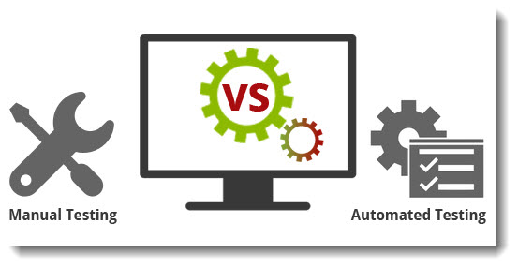
AUTOMATED VS. MANUAL TESTING
Notes:
NOTE:
To change the image on this slide, select the picture and delete it. Then click the Pictures icon in the placeholder to insert your own image.

Slide 4
Manual Tests
Coding Process with Manual Tests
Write code
Uploading the code to some place
Build it
Running the code manually (in many cases filling up forms etc. step by step)
Check Log files, Database, External Services, Values of variables, Output on the screen etc.
If it does not work, repeat the above process
Notes:
Build the code/software->One of the most important steps of a software build is the compilation process, where source code files are converted into executable code.

Slide 5
Automated Tests
Coding Process with Automated Unit Tests
Write one or more test cases
Auto-compile and run to see the tests fail
Write code to pass the tests
Auto-compile and run
If tests fail -> make appropriate modifications
If tests pass -> repeat for next method
Coding Process with Automated Functional Tests
Finish writing code (with all unit tests passing)
Write a Functional Test using any tool
Auto-compile and run
If tests fail -> make appropriate modifications
If tests pass -> move ahead

Slide 6
Automated Tests vs Manual Tests
Effort and Cost
Lets assume 6 test cases
Effort required to run all 6 manually => 10 min
Effort required to write unit tests for all 6 cases => 10 min
Effort required to run unit tests for all 6 cases => < 1 min
Number of testing iterations => 5
Total manual testing time => 50 min
Total unit testing time => 10 min
Release | Manual Test | Auto Test | Manual Test Cumulative
1 | 10 | 10 | 10
2 | 10 | 0 | 20
3 | 10 | 0 | 30
4 | 10 | 0 | 40
5 | 10 | 0 | 50

Slide 7
Automated Tests vs Manual Tests
Effort and Cost
Adding incremental Unit test cases is cheaper than adding incremental Manual Test Cases
Manual Testing is boring
None wants to keep filling the same forms
People tend to neglect running manual tests
None maintains a list of the tests required to be run if they are manual tests
Automated Tests on the other hand are code
They are fun and challenging to write
They require analytical and reasoning skills
They represent contribution that is usable in the future

Slide 8
Automated Tests vs Manual Tests
Manual Testing is not reusable
The effort required is the same each time
Automated Tests are completely reusable
IMPORTANT: One needs to setup a Continuous Integration Server, a common Code Repository and an organization structure
Once written the Automated tests, they can be reused without any additional effort for the lifetime of the Project
Notes:
Continuous Integration (CI) is a software development practice where members of a team integrate their work frequently - usually each person integrates at least daily - leading to multiple integrations per day. Each integration is verified by an automated build (including test) to detect integration errors as quickly as possible.

Slide 9
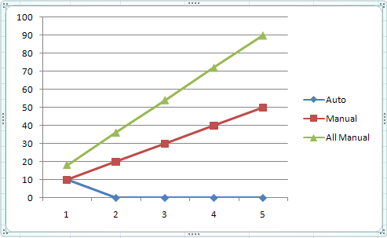
Automated Tests vs Manual Tests
Manual Tests provide limited Visibility and have to be Repeated by all Stakeholders
Only the developer testing the code can see the results
Tests have to be repeated by each stakeholder
For eg Developer, Tech Lead, GM, Management
Automated Tests provide global visibility
Developers, Tech Leads and Management can login and see Test Results
Release | Manual Testing by Dev | Manual Testing by Team Leads | Manual Testing by Mgmt | Total Manual Testing | Auto Test | Dev Manual Test Cumulative | Total Manual Test Cumulative
1 | 10 | 5 | 3 | 18 | 10 | 10 | 18
2 | 10 | 5 | 3 | 18 | 0 | 20 | 36
3 | 10 | 5 | 3 | 18 | 0 | 30 | 54
4 | 10 | 5 | 3 | 18 | 0 | 40 | 72
5 | 10 | 5 | 3 | 18 | 0 | 50 | 90

Slide 10
Automated Tests vs Manual Tests
Manual Testing ends up being an Integration Test
In a typical manual test it is very difficult to test a single unit
In most circumstances you end up checking the unit along with backend services
Automated Tests can have varying scopes
One can test a unit (class / method), a module, a system etc.
Manual Testing has a high risk of missing out on something
Automated Tests have zero risk of missing out a pre-decided test

Slide 11
Automated Tests vs Manual Tests
Automated Tests and TDD / Test-First development drive design
Writing a Unit test first clarifies the requirement and influences design
Manual Tests have no training needs
Automated Tests act as documentation
They provide visibility into different use cases and expected results
A new developer can understand a piece of code much more by looking at Unit Tests than by looking at the code. Unit Tests define the expected behavior of the code

Slide 12
Why do people not write Automated Tests
Initial learning curve
Understanding Unit Testing Frameworks and Functional Testing Frameworks
Understanding Continuous Integration and effective usage of it
Understanding and learning Code Coverage Tools
Figuring out how to organize the tests
How to create Mock Objects?
How to automate the running of the tests each time?
Where to commit/apply the tests?
Am I really going to be working on this same module again?
Will my tests be re-used?
Notes:
Mock objects are instances of test-provided classes that simulate the behaviour of external components. Mock objects isolate the application code under test. They create conditions that are otherwise difficult to produce, such as a disk full exception.
Commit-> Apply

Slide 13
Why do people not write Automated Tests
Solution
Spend time during First Release to design / implement
A Code Repository structure that incorporates Unit Tests and Functional Tests
A CI Server integrated with the release
Unit Testing Framework (any x Unit framework)
Functional Testing Tools (Sahi / Selenium / QTP etc)
Code Coverage Tools (Clover)
Testing guidelines and principles
Designate Responsibility
Each developer MUST write Unit tests for multiple use cases
Designate a specific Developer to write Functional Tests
The developer who writes the tests is also responsible for organizing them, committing them and linking them in CI

Slide 14
Why do people not write Automated Tests
Don’t give up
If you come across a hurdle
Make sure you complete your testing responsibility
Check Code Coverage
Use code coverage tools while coding and post-coding to check parts of your code that are covered by tests
How do managers generally decide when to automate?
Decision is based on factors like:
Efforts required to run manual test
Frequency of testing
Cost of third-party / in-house developed tool
Efforts required to write automated tests

Slide 15
Simplistic Cost Model
In cost benefit analysis of test automation, benefits of test automation are hard to quantify
Many estimates conducted in industrial projects are limited to considerations of cost only
In many cases the investigated costs include:
The costs for the testing tool or framework,
The labor costs associated with automating the tests
The labor costs associated with maintaining the automated tests
These costs are divided into
Fixed costs
Variable costs
Fixed costs are the upfront costs involved in test automation.
Variable costs increase with the number of automated test executions

Slide 16
Simplistic Cost Model
V = Expenditure for test specification implementation
D = Expenditure for single test execution
Costs for a single automated test (Aa) can be calculated as:
Aa = Va + n * Da
A_{a} = Overall cost of automated testing for some # of times
V_{a} = Estimated Cost of designing automated tests (may also include cost of test tool)
Da= Expenditure for single automated test execution
Cost for manual test execution of a single test case (Am) is calculated as
Am = Vm + n *Dm
A_{m} = Overall cost of manual testing for some # of times
V_{m} = Estimated Cost of designing manual tests
Dm= Expenditure for single manual test execution

Slide 17
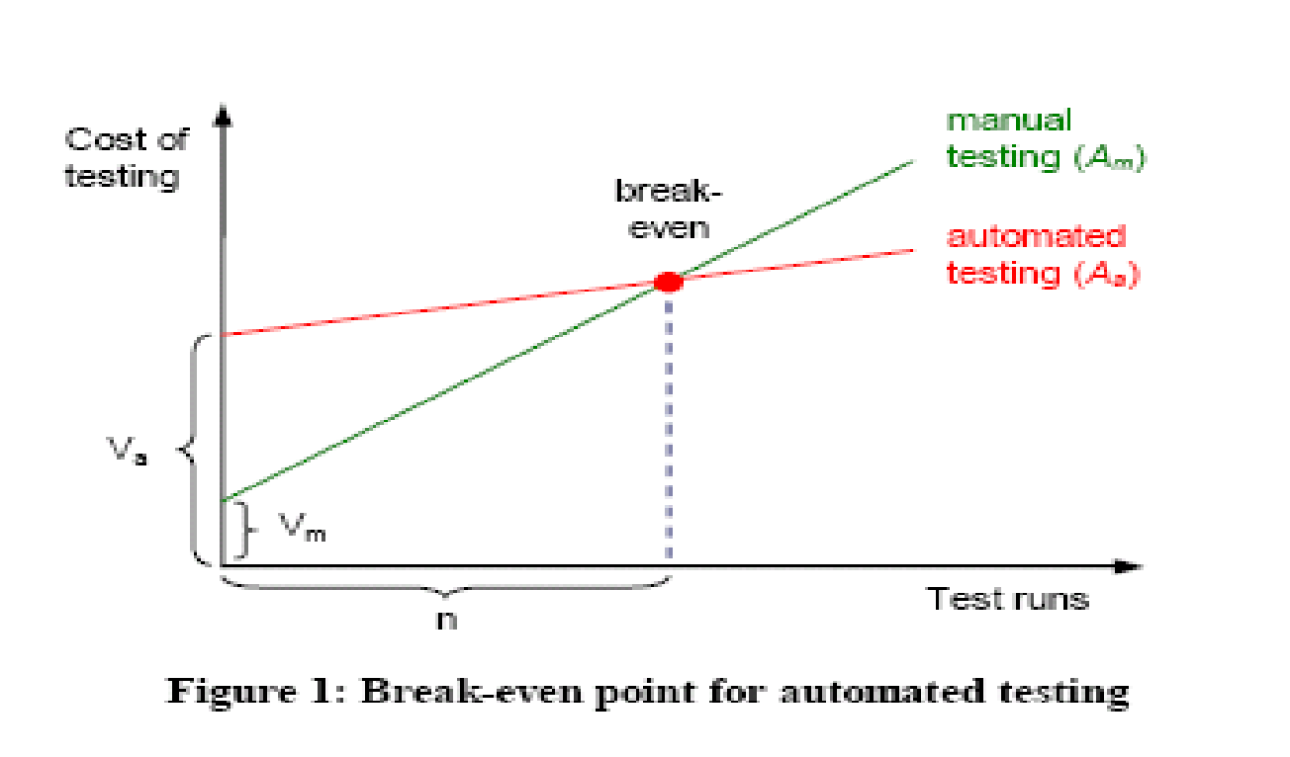
Simplistic Cost Model
The break-even point for test automation can be calculated by comparing the cost for automated testing (Aa) to the cost of manual testing (Am) as:
E(n) = Aa / Am = (Va + n * Da )/ (Vm + n * Dm )

Slide 18
Simplistic Cost Model - Flaws
Manual & Automated Testing are not comparable
Exploring new functionality vs regression testing
Only costs are analyzed not benefits
Manual testing starts early in the process but some latency in automated testing
All test cases & executions are considered equal
Project Context (budget, resources) not considered
Misses additional cost factors like training on the testing tool, new process adaptation

